Slide 1
Honeywell
APM
May 2024
User Training – Asset Performance Management
Honeywell Internal

Slide 2

Safety and code of conduct
Please review all Emergency exits; be alert for Alarm signals;
Please follow the safety procedures of your workplace;
Please switch off or silence your mobile;
Please have one conversation only;
Please speak up, ask questions;
Please follow the COVID guidelines of your workplace;

Slide 3
Agenda
Module 2:
APM screens
System Access
Asset Sentinel
Asset Hierarchy
Contents Tab
Asset Status-Dashboard , Heat Map
Performance Overview
Event Workflow
Event management
Event Monitor
Details View and Asset Details
Fault Tree
Asset Trends
External Datasources
Calculation Status Viewer
Reports
APM DCT
Module 1:
APM Overview
Key features of Asset Sentinel
Interfaces
Integrated Workflow
Event Investigation & Resolution
Fault Reports & Metrics
APM Concepts
Asset Class & Types
Assets & Asset Hierarchy
Asset Attributes
Asset Models
In-built Calculation Models
Asset Indices
Asset Status & Rating
Asset Links
Data Cleansing

Slide 4
Module 1:
APM Overview
Key features of Asset Sentinel
Interfaces
Integrated Workflow
Event Investigation & Resolution
Fault Reports & Metrics
APM Concepts
Asset Class & Types
Assets & Asset Hierarchy
Asset Attributes
Asset Models
In-built Calculation Models
Asset Indices
Asset Status & Rating
Asset Links
Data Cleansing

Slide 5
MODULE 1
APM Overview

Slide 6
Key Features of Asset Sentinel
Near real time equipment condition monitoring
Calculates key equipment performance KPIs
Compares deviation from expected behavior
Easy identification of root cause for any deviations
Pre-defined recommendations for faults
In-built library of major equipment models
Library of templatized equipment graphics
Has a powerful calculation engine with several pre-built functions which can be used for generic calculation purposes as well
Different visualization options: Heat Map, Fault Tree, Table, Trends and Graphics
Alerts to Engineers through email
Can read data from multiple data sources eliminating manual data collection
Cleanses data before using in models
Allows linking of all related documents
Can interface with Unisim for complex models
Notes:
Uniformance Asset Sentinel application in a plant to monitor the reliability of equipment such as, pumps, valves, compressors, heat exchangers, and to identify any failure/fault.
The monitoring and quick identification of failures helps in taking decisions and planning for maintenance.

Slide 7


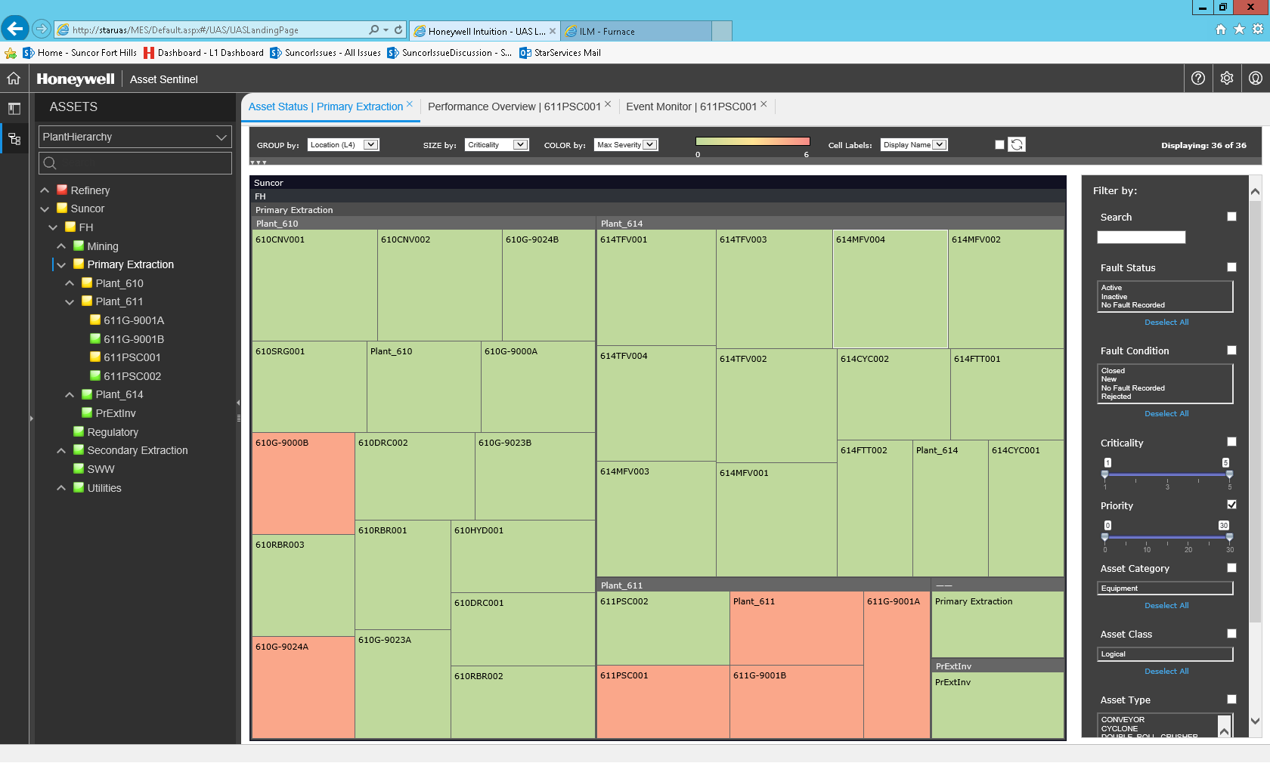

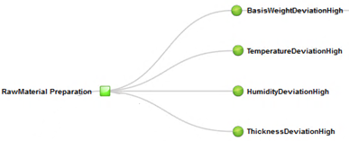
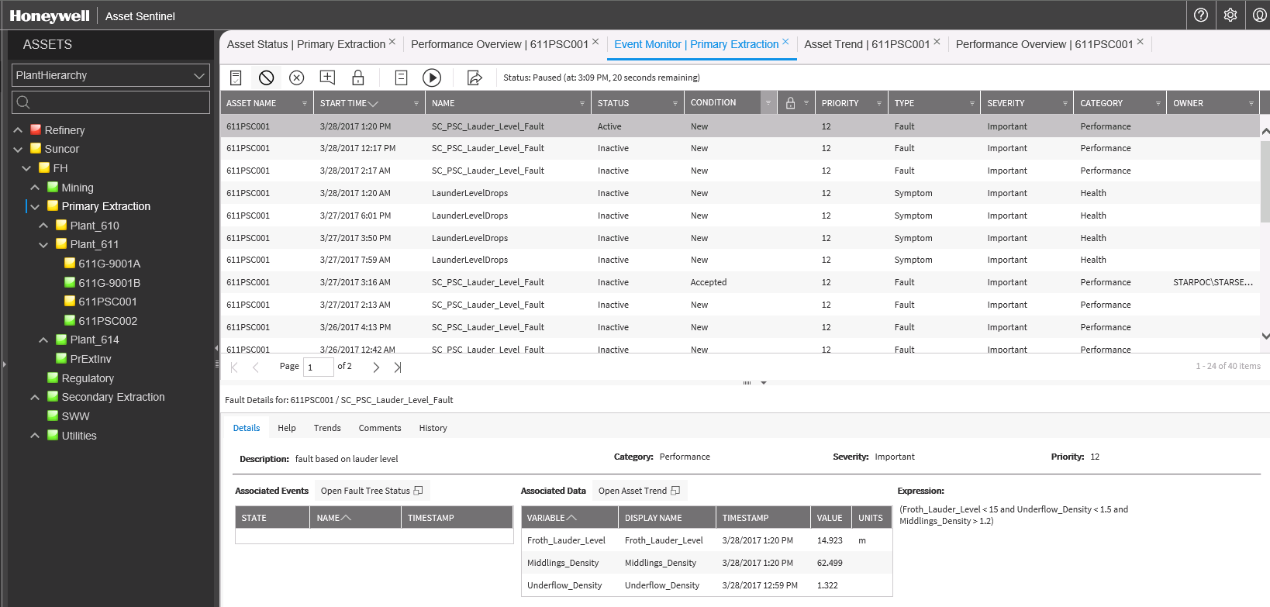

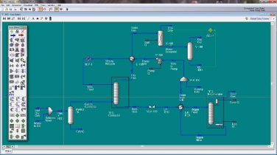
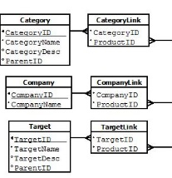
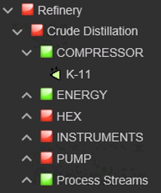

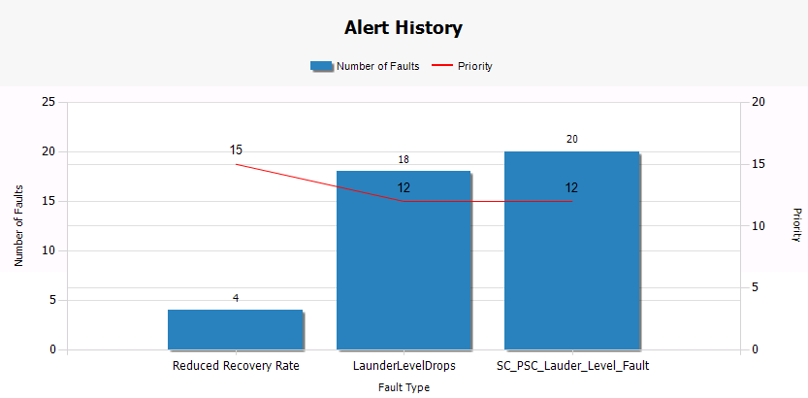
APM Overview
Standard Connectors
Calculations (Runtime Analytics) (Complex Event Processing Engine)
Even Detection
Event Management (Monitor & Investigate)
Sensor (tag) Data
Pre-Processing / Cleansing
Actual vs. Predicted
Pump
Asset Status (Heatmap)
Head =3960*HP / Flow
Historian Data
User Defined Calculations
Exchanger
Fault Models
Alarms/Events
Compressor
UniSim® - Estimate/ Predicted
Event Monitor & Investigate
Turbine
Other…
Furnace
Content
Library
Fault Prioritization
(Fault Severity * Asset Criticality)
Trends, Graphics & Reports
Continuously Monitor & Take Action
Notes:
Template models and calculations – build and manage in one place
Asset centric models to navigate plant hierarchy
Human Readable data access vs. cryptic tag names
State-of-the-art engineering calculation engine
Embedded Content major process/equipment models and thermo library
Powerful data pre-processing and post-processing engine
Continuous monitoring for early notifications and alerts on impending issues
Manage workflow for issue resolution

Slide 8
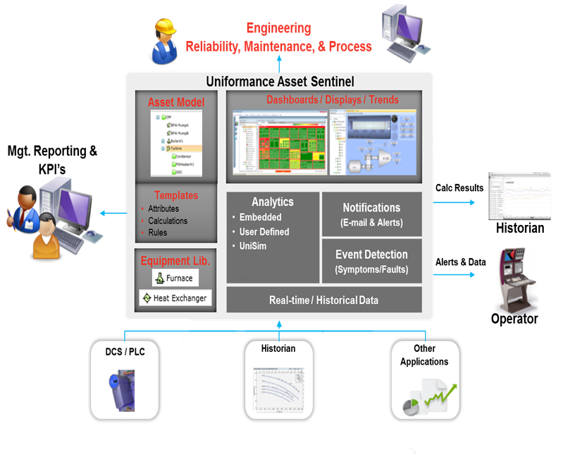
interfaces
Notes:
Many sites complain that after having an asset fail they do the root cause analysis and after the fact see that they had high motor current, high temperature, and reduced effeciency right before the failure. They lament that if they had a system that could pro-actively alert them to this condition they would be able to prevent these situations.
Asset Manager is being used successfully at BP Hull, PetroCanada, and the Dolphine project and others as a ‘consolidator’ of equipment condition and determine from all the various sources what the current ‘condition of the asset is.
For example at PetroCanada they are using it to monitor all their key compressors looking at vibration and bearing temp from the Bently Nevada system and the seal flush temperatures, and flows.
On many occasions the reliability engineers have received email alerts indicating that a rate of change in the oil temperature has occurred and they will investigate and there has been a malfunction. In one particulare case after a major repair they got an alert and found that the valve for the seal flush was still closed. If this had not been detected the compressor would have quickly failed and caused another costly outage.

Slide 9
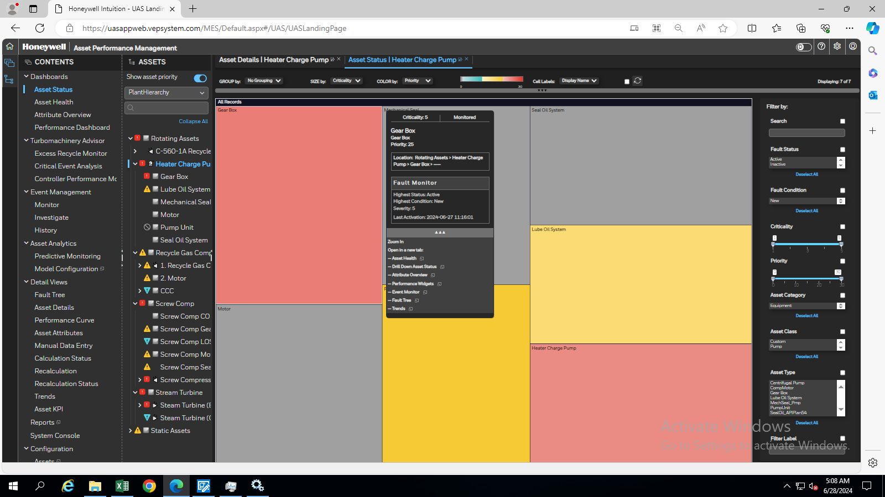

Integrated Workflow – Detect & Decide
Detect
Asset Overview
Notes:
An example of how customers use the solution is based on this real-life scenario which shows the integrated workflow.
For example, if a rate of change alert in the oil temperature has occurred
A process engineer or reliability engineer either receives an email notification or sees a status change on the Asset Sentinel Dashboard. This enables him to initiate an investigation and drill into the problem looking at trends, event summary to see the contributing cause, and view equipment displays.
In one such case, immediately after a major compressor overhaul the engineer received an this type of alert and the investigation found a seal flush valve problem. If this condition had not been detected the just overhauled compressor seal would have quickly failed and caused another costly outage and potentially significant damage.
9

Slide 10
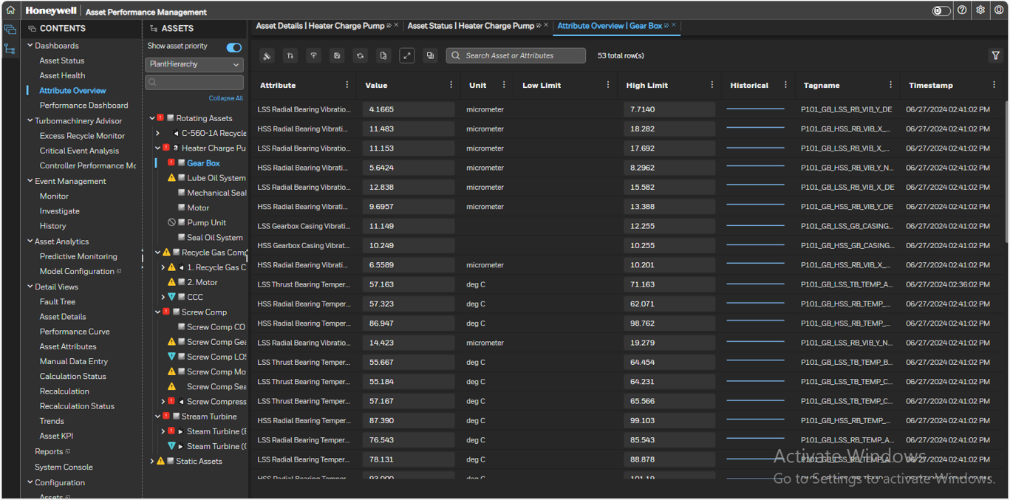
Integrated Workflow – Detect & Decide
Detect
Attribute Overview
Notes:
An example of how customers use the solution is based on this real-life scenario which shows the integrated workflow.
For example, if a rate of change alert in the oil temperature has occurred
A process engineer or reliability engineer either receives an email notification or sees a status change on the Asset Sentinel Dashboard. This enables him to initiate an investigation and drill into the problem looking at trends, event summary to see the contributing cause, and view equipment displays.
In one such case, immediately after a major compressor overhaul the engineer received an this type of alert and the investigation found a seal flush valve problem. If this condition had not been detected the just overhauled compressor seal would have quickly failed and caused another costly outage and potentially significant damage.
10

Slide 11
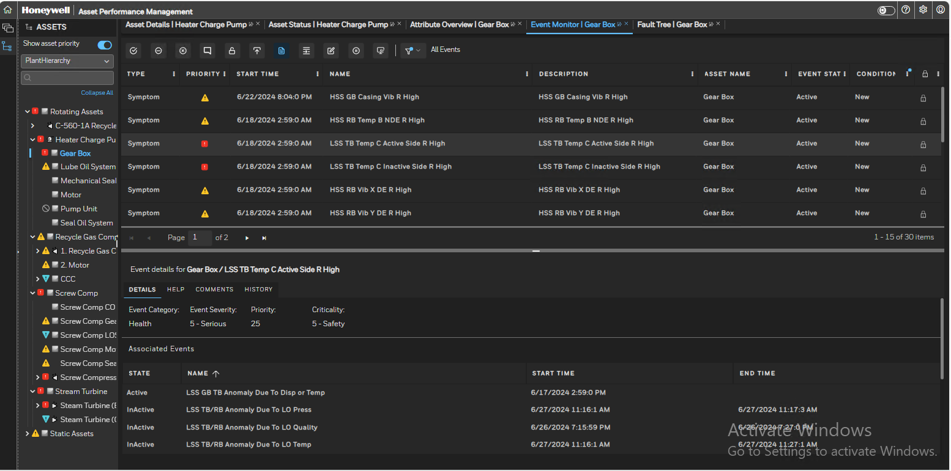
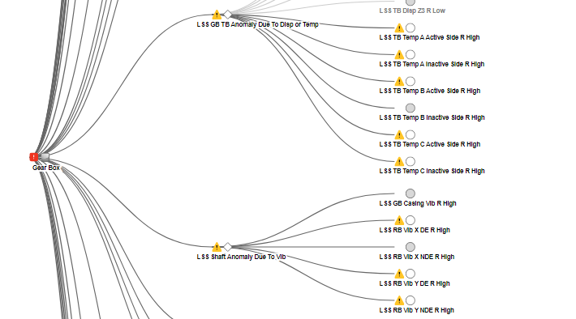
Integrated Workflow – Decide
Decide
Event Monitor
Notes:
Fault Tree –It’s a graphical representation/display of an asset and associated faults and symptoms
It help to locate the source of the Fault in a single view.
11

Slide 12
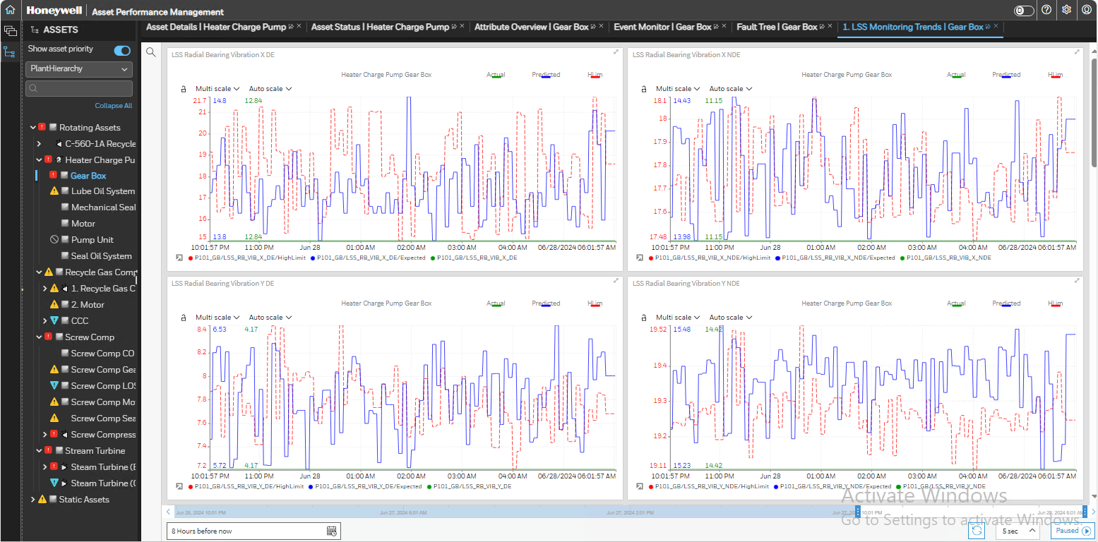
Event Investigation – Trends & Graphics
Decide

Slide 13
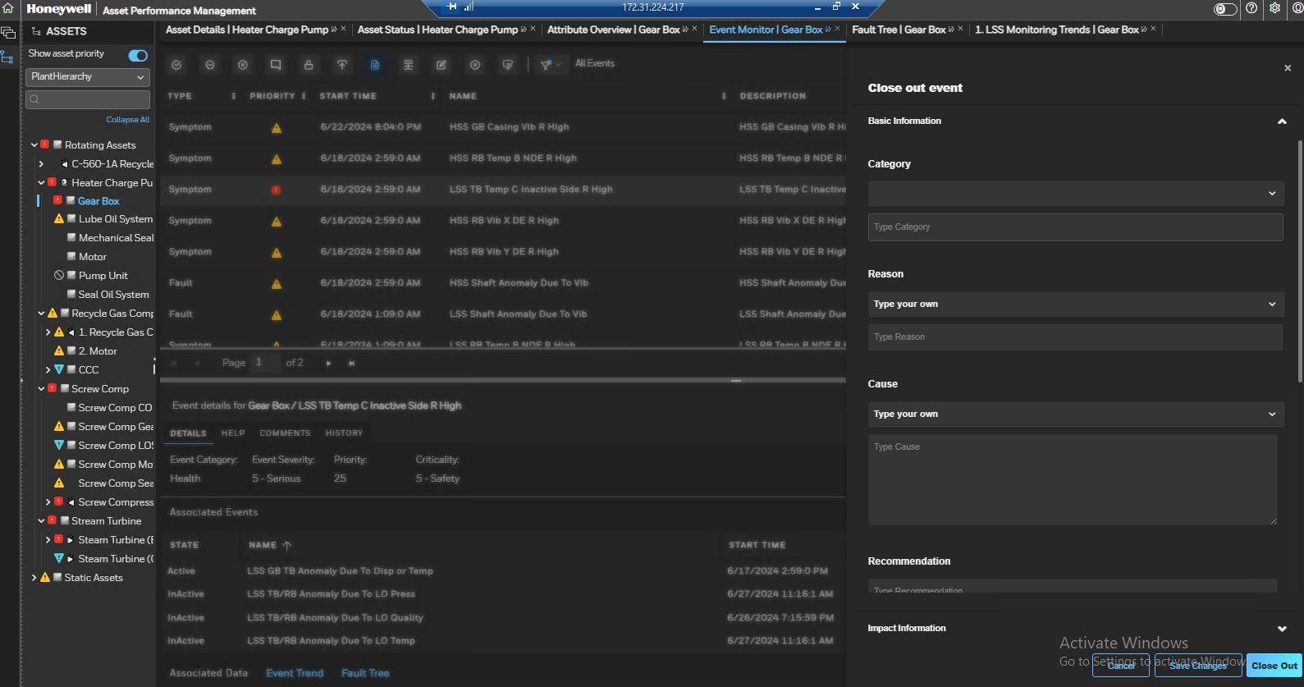
Event Resolution / Close-out
Act

Slide 14
MODULE 1
APM Concepts

Slide 15
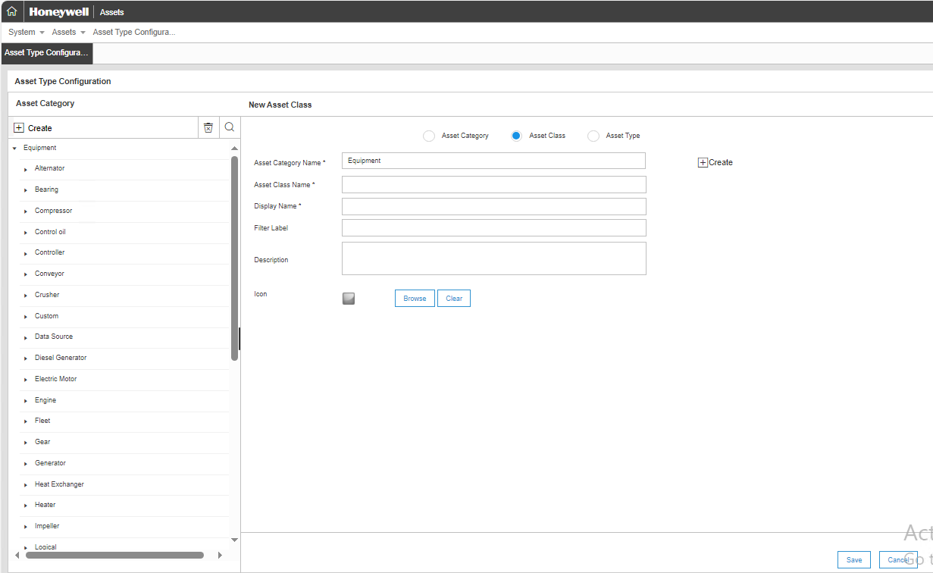
Asset class & Types
Asset Sentinel categorizes assets by “Type” and “Class”. All assets below the site level have class and type definitions, which allow you to create tasks for similar assets. Hierarchical structure of Asset Sentinel is:
Asset class
Asset type
Assets
Asset Class
Asset Classes occupy the highest level in the hierarchy, which are made up of similar asset types.
An example of an asset class is a Pump. Different types of pumps like the centrifugal pump, reciprocating pump, rotary pump and so on are grouped under pump class.
Asset Types
Asset Type occupies the next level immediately after the asset classes in the hierarchy. These types are grouped based on their similarities.
They represent the primary purpose of the asset, model and the revision of the device. Asset Sentinel displays the common asset types and provides the ability to create the custom asset types.
When you consider an example of a Turbine class, Wind turbine, steam turbine, hydroelectric turbine, gas turbine and so on are similar sets of asset types grouped or associated to turbine class.

Slide 16
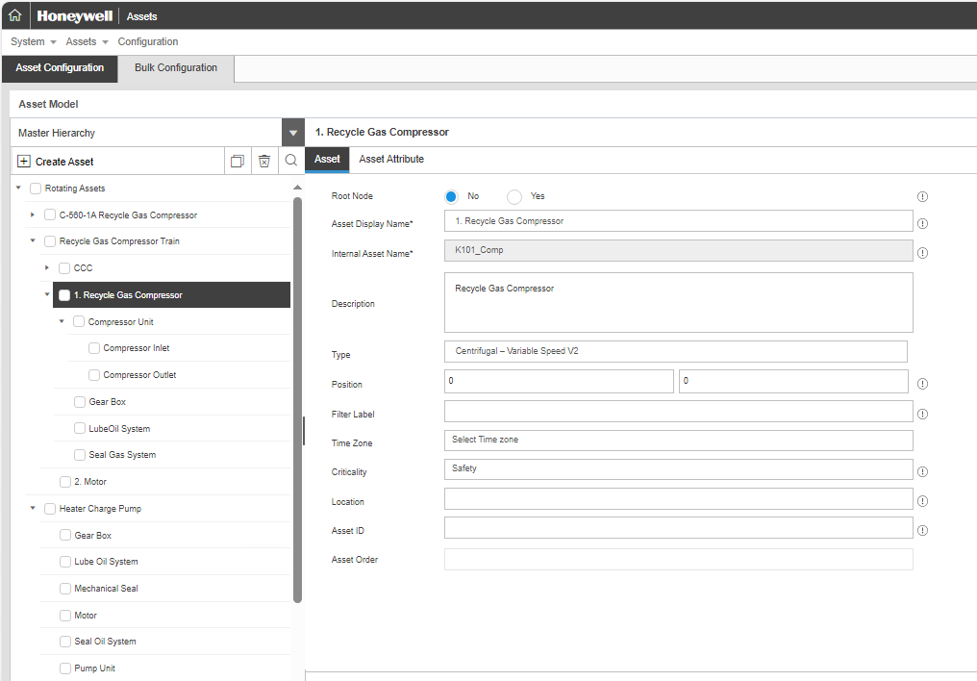
Assets & asset hierarchy
Assets
Asset is the last level in the hierarchy, where you specify a unique asset name that identifies the asset/instrument in a plant. For example, the asset name “1071P0130AB” identifies a particular equipment in a plant.
Asset Hierarchy
In the Asset Sentinel application, an asset hierarchy is a framework, which classifies an asset into several segments and represents it in the tree view. Each segment in the hierarchy will consists of the asset class, asset types and the asset.
The hierarchy is a graphical representation of your database hierarchy. The purpose of a hierarchy is to enable you to view the whole structure of the plant in a graphical tree structure.
You can create, modify, and delete nodes in the hierarchy. By default you can view only the root node when you create the hierarchy for the first time. You will have to build the hierarchy by assigning different segments.
You can specify any number of levels in the hierarchy.
Here we have specified four levels:
Site
Plant
Unit
Equipments

Slide 17
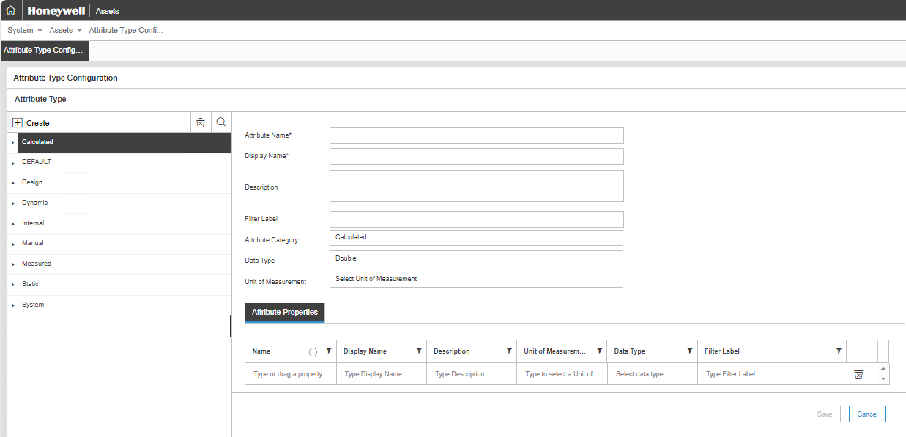
Asset attributes
Attributes
An attribute refers to a parameter that is associated with an asset. In the context of Asset Sentinel, an asset attribute can either be an input parameter that is measured for the asset in the field or it can be a design parameter or it can be an output KPI (Key Performance Indicator) that defines the performance of the asset.
Attributes are defined at asset type level. They are classified into 2 categories:
Static
Dynamic
Static attributes refer to attributes whose value is either constant or is changed manually by a user (e.g. field values). Dynamic attributes refer to attributes whose value is read from a tag or written to a tag.
The data type of attributes can be either of the below:
Float
Integer
String
Double
Array
Tabular Array
Double Array
Attributes are associated with a filter category. Filter categories allow users to easily filter the required attributes while analyzing the performance of an asset.

Slide 18
Attribute PROPERTY
Attribute Property
Properties are additional information of attribute to support improved visualization and managing attribute. Custom Properties can be used in calculation or fault model by specifying "Attribute.Property". For example: FlowRate.Cleansed > FlowRate.HighLimit.

Slide 19
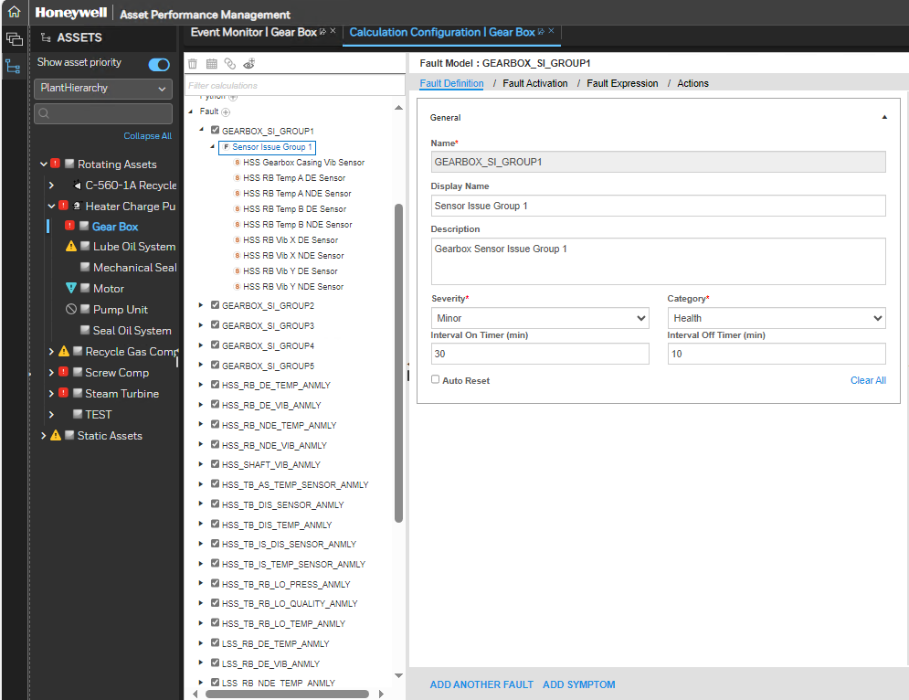
Asset models
A model-based approach is widely used across many manufacturing plants to reduce the amount of energy and time spent on the low performing equipments. A fault model is a model that discovers how the system handles some common failures, which contribute to the unsafe situations. Fault models are more abstract than the models of normal behavior. They are easy to construct, comprehend and customize. They can easily capture interactions between the root cause (faults) and their effects (symptoms) without requiring a detail model to simulate the normal behavior.
The two models available in Asset Sentinel are:
Fault-Symptom Model
Calculation Model
Fault-Symptom Model
A Fault-Symptom model is a model used to identify the faults (failure) and the symptoms in an asset. They are generally defined at the type level. The Asset Sentinel application is a decision-support system, where the problems are identified and repaired by tracking the asset failures and symptoms.
A Fault-Symptom model generally consists of faults and symptoms. While building a fault model, it is mandatory to have at least one fault whereas the number of symptoms can be optional.
Asset type attributes are used to configure expressions for symptoms and both asset type attributes and symptoms are used to configure expressions for faults.
During evaluation, the symptoms are executed first and the faults afterwards.

Slide 20
Asset models
Fault-Symptom Model
A Symptom is a state or condition at which a symptom of a fault is identified. These are defined with a condition expression on the asset attributes. Whenever there is a fault activated in the system, and one symptom is active, the state of the fault gradually changes its state to a potential fault. This fault moves to a confirmed state only when the condition of the fault is satisfied. The repair actions associated to these faults are activated and the respective groups are notified.
A Fault is a state or condition at which a functional failure is identified. These are defined with a conditional expression on the asset attribute.
A Fault or symptom occurrence is called as an event. The event can move to the following states:
Potential : one or more symptoms is active, but the fault conditions have not been reached.
Active : the expression associated with the event (for example, a fault or symptom) returns value of !=0.
Inactive (Deactivated) : the expression associated with the event (for example, a fault or symptom) returns value of 0.
Accepted : the event haves been accepted by a user to address.
Locked : event is locked by the user so the state does not change irrespective of the fault or the symptom condition. This is typically used to avoid duplicate events when the event is being addressed in field.
Closed : event has been closed by the user (includes a record of the reason code, comments).
Rejected : event has been falsely identified by the system and rejected by a user (possibly marked as a false positive).
Limits are values used for identifying the fault/symptom conditions of an asset. They can be:
Constant values based on engineering/design limits
Alarm limits from historian
Calculated limits based on other parameters like gas production

Slide 21
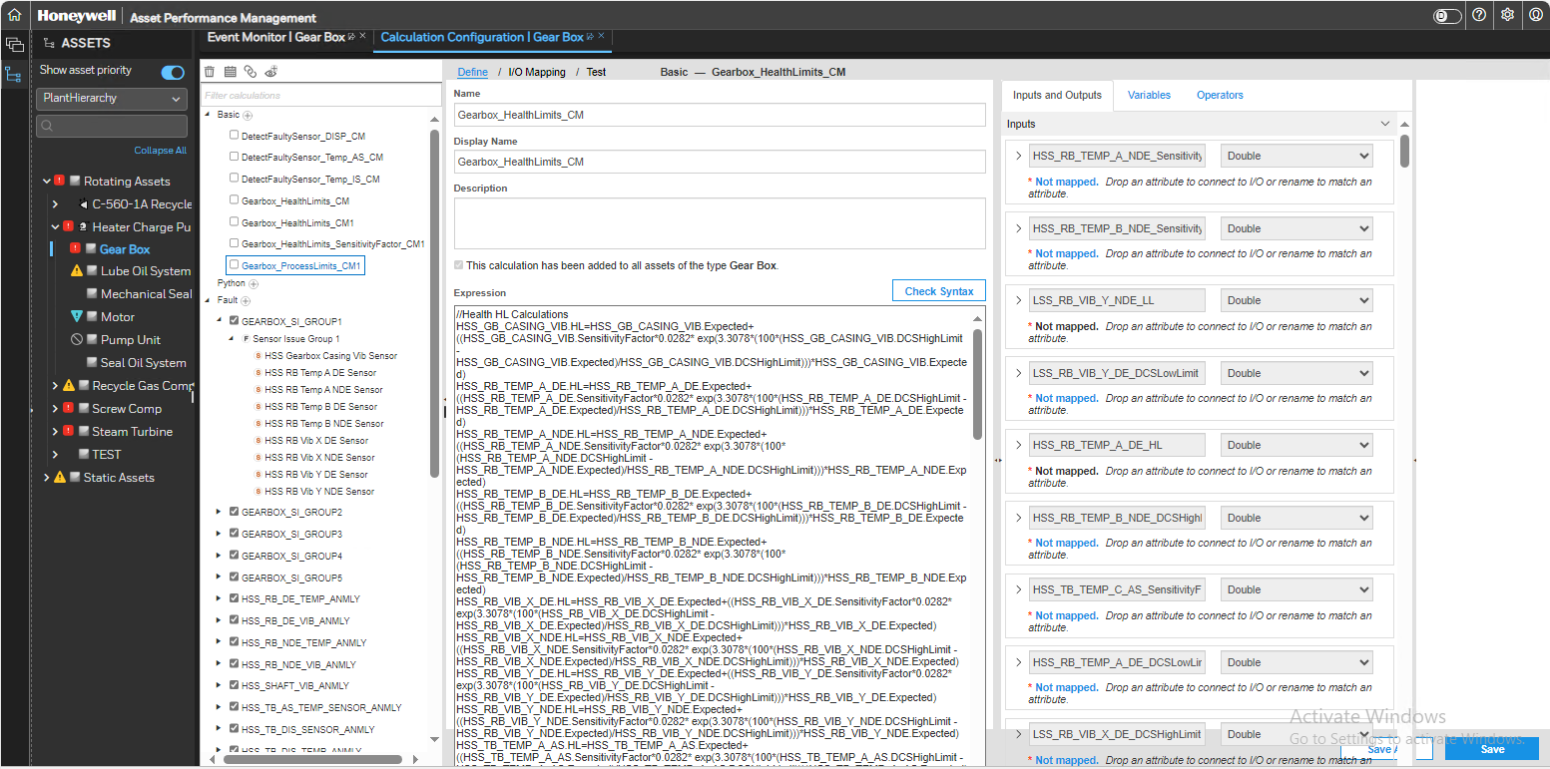
Asset models
Calculation Model
A calculation model in Asset Sentinel is a model that defines calculations or logics on the asset attribute values. The attribute values are updated based on the calculation or logic defined in the application. Asset Sentinel supports various operators to define the calculation model.
A calculation model in Asset Sentinel is a model that defines calculations or logics on the asset attribute values. The attribute values are updated based on the calculation or logic defined in the application. Asset Sentinel supports various operators to define the calculation model. This is not limited to physical entity but is extended to logical entities such as Plant, Area, Unit and Sections.

Slide 22
In-built calculation models
The calculation models within Asset Sentinel can be classified as:
In-built models
Custom models
The in-built models can be further classified as:
Advanced models or 1st principle-based models
Thermo stream models
Advanced Models
The advanced models are available within Asset Sentinel for the following asset types:
Centrifugal Compressor (Constant Speed, Variable Speed, Variable Guide Vane)
Centrifugal Pump
Furnace/Heater
Steam Turbine (Constant Speed, Variable Speed; Condensing, Back pressure)
Gas Turbine
Shell and Tube Heat Exchanger
Thermo Stream Models
Most advanced models need stream property data like enthalpy, entropy, molecular weight, Cp, Cv, etc., for computation of the final KPIs.
This is facilitated by utilizing the thermo stream models. There are some models already available within the APM standard library.
Any additional models can be exported from Unisim. Not all thermo property packages of Unisim can be exported.
The default advanced models use BWR thermo package. This is most suitable for steam service.
The most frequently used package for hydrocarbon service is Peng-Robinson (PR).

Slide 23
Asset indices
Health Index
Health Index refers to the physical health of an equipment. In Uniformance Asset Sentinel, for all the rotating equipment, the health indices are computed by custom calculations based on the limit differences between current value and expected operating values for various mechanical/electrical condition parameters. The value of the health index is 0 to 1 where 0 is healthy and 1 is unhealthy.
Performance Index
Performance Index refers to the process performance of an equipment. In Uniformance Asset Sentinel, the advanced equipment models for assets such as turbine, compressor and pumps calculates actual and expected performance at current operating conditions. The same can also be configured for other asset type to compare performance of various assets across the fleet. The value of the performance index is calculated based the deviation of actual and expected between 0 to 1, where 0 is bad performance and 1 is good performance.
Example PerformanceIndex = ((ExpectedHead - OperatingPolyHead) / ExpectedHead)
Energy Index
Energy Index refers to the energy efficiency of an equipment. The energy term can be shaft power or heat duty and so on which is calculated by advanced models for asset type such as turbine, compressor and pumps calculates actual and expected energy consumption at current operating conditions. The same can also be configured for other asset type to compare performance of various assets across the fleet. The value of the energy index is calculated based the deviation of actual and expected between 0 to 1, where 0 is bad performance and 1 is good performance. Note: Thermo dynamic property packages are available to compute energy consumption through engineering scripting calculations.
Example OperatingShaftPower= abs((ExpectedShaftPower - OperatingShaftPower) / OperatingShaftPower)
Duty= E101Feed.Flow * E101Feed.Cp *( OutletT-inletT)

Slide 24
Asset status & rating
Asset Status
Asset status changes in field due to planned maintenance, unexpected event and trip unit or put in service. In Uniformance Asset Sentinel, the asset is in one of the following modes or states:
Monitor: Asset calculations and rules are configured to execute. The asset is available for operation when required.
UnMonitor: Asset calculations and rules are disabled. The asset is available for operation when required.
OutofService: Asset calculations and rules are disabled. The asset is NOT available for operation.
Each asset status is mapped to an icon image, which is displayed in the asset hierarchy.
Asset Rating
The Uniformance Asset Sentinel application uses the following 3 asset concepts to determine the relative importance of an asset and an event.
Criticality
Severity
Priority
Criticality is an attribute (numeric value) associated to an asset. It denotes the relative importance of an asset based on financial and safety considerations.
Severity is an attribute (numeric value) associated with faults and symptoms. It indicates the relative performance impact (severity) of the fault and symptom on an asset.
Priority is a parameter of an asset which indicates the health of the asset. The priority value is calculated by multiplying the numeric values of severity and criticality. The priority value determines the asset’s icon colour which indicates a fault. It enhances sorting capabilities within the asset’s view.
Value | Criticality
1 | None
2 | Negligible
3 | Minor Process
4 | Major Process
5 | Safety
Value | Severity
1 | None
2 | Minor
3 | Required
4 | Important
5 | Serious
6 | Critical

Slide 25
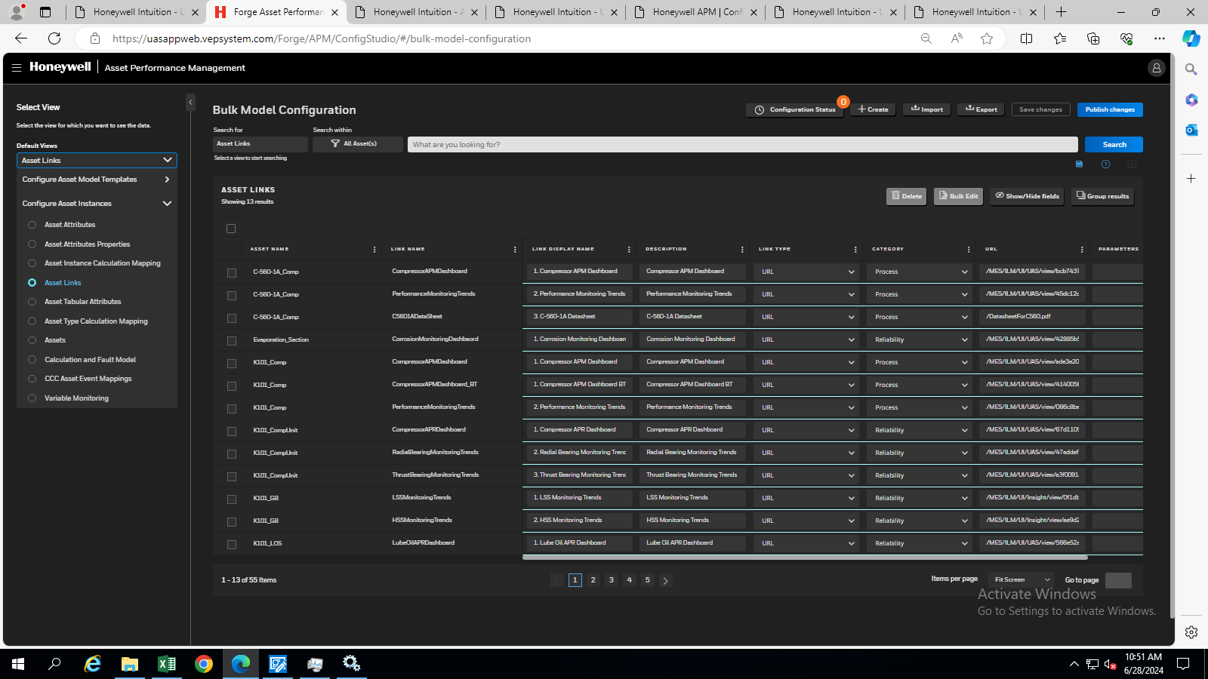
Asset links
Asset Status
Assets can be configured with a link to additional information in a document (pdf or word format) or a URL. For example, an asset can be a link to a saved Performance Curve to allow quick access to information about asset performance.
Asset Link Templates are URL defined with or without a standard parameter, such as asset name or display name. Asset Link Templates are associated to the asset type.
Go to configuration studio and search for Asset links, as shown in screenshot below.
Asset Links or link instances are configured on an individual asset manually or created from the links associated to their respective asset template.

Slide 26
Asset metrics
Uniformance Asset Sentinel provides pre-configured asset metrics template for assets in the Equipment category. Once imported, these metrics can be applied to all assets in an asset category and the calculation can be used as an example for adding additional asset metrics to the assets.
S.No. | Metric Name | Description
1 | Asset Index | The “index” of the asset (Availability * Performance / 100).
2 | Availability | The availability of the asset (the percentage of time asset is available).
3 | Metrics Start Date | The time-stamp of when an asset started recording metrics.
4 | Performance | The performance of the asset (the percentage of time asset is not faulty).
5 | Running Cycles | The number of times the asset has been started since the last maintenance cycle. Reset at the end of each maintenance cycle.
6 | Status (Faulted) | The faulty status of the asset: Not faulting, Faulting or Potentially faulting.
7 | Status (Maintenance) | The maintenance status of the asset: Not in maintenance, Planned maintenance or Unplanned maintenance.
8 | Status (Running) | The running status of the asset: Not running or Running.
9 | Status (Uptime) | The uptime status of the asset: In Service/Monitored, Unavailable/Unmonitored, Unknown, Out of Service or Unlicensed.
10 | Time (Downtime) | The amount of time the asset has been unmonitored. Reset at the end of each maintenance cycle.
11 | Time (Faulted) | The amount of time the asset has been faulty since the last maintenance cycle. Reset at the end of each maintenance cycle.
12 | Time (Maintenance) | The amount of time the asset has been in maintenance. Reset at the end of each maintenance cycle.
13 | Time (Running Cumulative) | The cumulative amount of time the asset has been running.
14 | Time (Running) | The amount of time the asset has been running since the last maintenance cycle. Reset at the end of each maintenance cycle.
15 | Time (Uptime) | The amount of time the asset has been monitored. Reset at the end of each maintenance cycle.

Slide 27
Data cleansing
Industrial data is often not suitable to use in its raw form for model execution due to:
Noise
Uncertainties
Disturbances
Pre-processing of available measured data is a very important step in the plant data-based process modelling. The quality of model output relies heavily on the quality of input data. When calculations are made with bad data, false information is generated and poor or incorrect decisions are made. Hence Asset Sentinel has in-built data pre-processing model which can be used to cleanse the incoming tag data and generate good quality data which can then be used in the asset models.
Asset Sentinel performs the following functions as part of the tag data pre-processing:
Range Validation
Range Low-Values which are below this threshold are marked as bad quality. Changing Range Low sets the Engineering Min for the attribute.
Range High-Values which are above this threshold is marked as bad quality. Changing Range High sets the Engineering Max for the attribute.
Freeze Check-Sentinel can generate events if the tag data is frozen for more than the minimum number of minutes configured.
Replacement-Sentinel replaces bad data by either replacing such data by interpolation, average, last good value or next good value.
Filtering-Sentinel uses following methods to generate the cleansed values:
EWMA
Loess
Average
Sentinel can generate events based on the data pre-processing settings configured.
Sentinel stores the cleansed process tag data in the embedded PHD tags. The cleansed value shall then be used in all performance calculations.

Slide 28
Module 2:
APM screens
System Access
Asset Sentinel
Asset Hierarchy
Contents Tab
Asset Status-Dashboard , Heat Map
Performance Overview
Event Workflow
Event management
Event Monitor
Details View and Asset Details
Fault Tree
Asset Trends
External Datasources
Calculation Status Viewer
Reports
APM DCT

Slide 29
MODULE 2
APM Screens

Slide 30
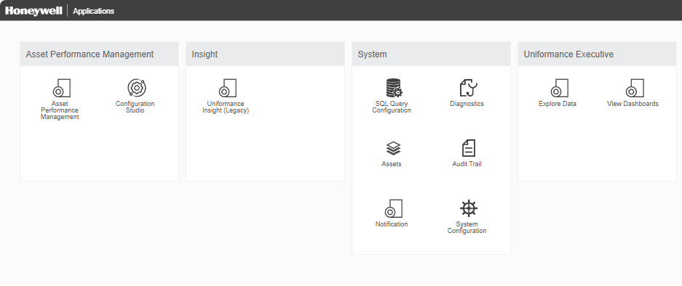
System access
The home page of APM can be accessed using the URL: http://<Server name>/MES/LandingPage.aspx
It has the following workspaces icon available:
Asset Performance Management
Asset Performance Management
Configuration Studio
Insight
Uniformance Insight(Legacy)
System
SQL Query Configuration
Diagnostic
Assets
Audit Trail
Notification
System Configuration
Uniformance Executive
Explore Data
View Dashboards

Slide 31
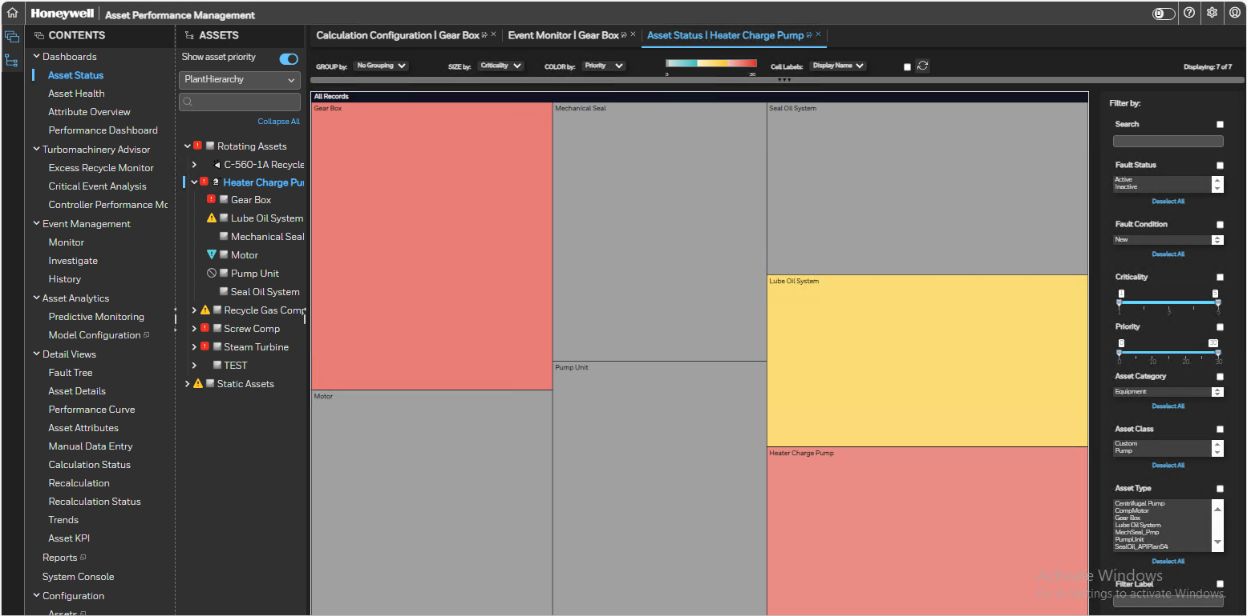
Asset sentinel
Asset Sentinel is the default page for use of the end users.
It has 3 parts:
Contents : Contains list of in-built screens and asset links.
Assets : Contains the asset hierarchy.
Workspace : Displays the selected screen for the selected asset.
The page opens by default at the “Asset Status” screen. It is a heat map showing the status of the assets. Each box in the heat map denotes an asset. The default size of the box is based on “Criticality” of the asset and the default colour is based on the “Priority” of the asset. The health of the green coloured assets is normal, yellow coloured assets is warning and red coloured assets is urgent.

Slide 32
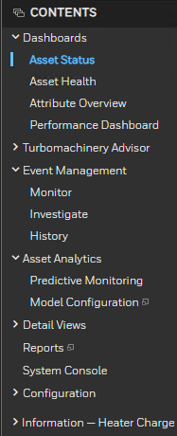
Contents Tab
The content tab is a list of all displays configured on the system. Selecting an item on the content tab opens the related display. The tab consist of 7 sections:
Dashboards
Turbomachinery Advisor
Event Management
Asset Analytics
Detail Views
Configuration
Information
The user can click on the arrow next to the asset to expand the hierarchy.
Some of the views in the contents tree can be opened either in the current tab, or in a new tab. If the option exists, the Open in New Tab icon appears when you hover the mouse over the selection in the tree.Alternately assets can be searched by their names or key words.
1.a
2
1.b
1.c
1.d
3
1.e
1.f
1.g

Slide 33
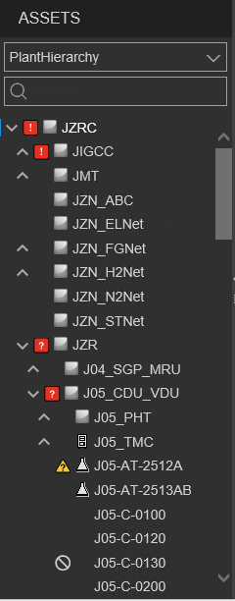
Asset Hierarchy
The plant hierarchy facilitates browsing Sentinel Content based on assets. The asset hierarchy starts with the complex level asset and then propagates in below fashion:
Complex
Site
Plant
Equipment
The user can click on the arrow next to the asset to expand the hierarchy.
Alternately assets can be searched by their names or key words.
Selecting an asset will display all the content details associated with the asset.
There is an ‘!’ mark adjacent to the Asset if there is an Active Fault for an Asset.
There is a ‘?’ mark adjacent to the Asset if there is a Potential Fault for an Asset.
1.a
2
3
5
1.b
1.c
1.d
6

Slide 34
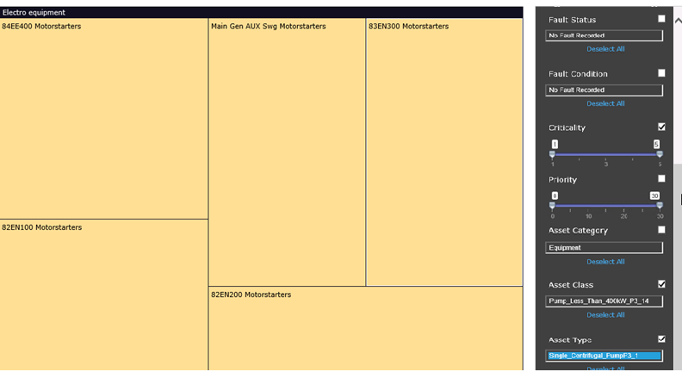
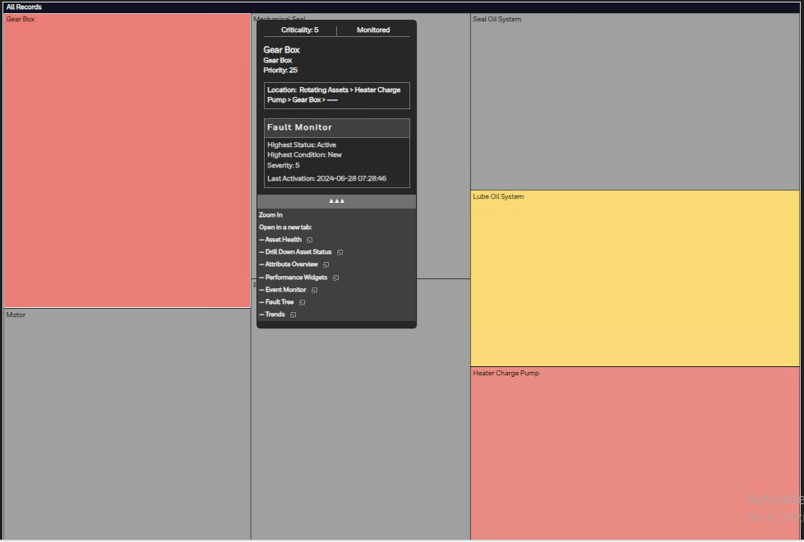
asset status-heat map
Asset Status page has a search option and additional filters available including filters for:
Asset Category
Asset Class
Asset Type
Fault Status
Fault Condition
Criticality
Priority
Clicking on any asset launches a pop-up window that displays the details of the asset along with the fault details. It provides navigation option for other views which will help in drilling down to the root cause.
The views can alternately be launched from the contents tree as well.
d
e
f
g
a
b
c

Slide 35
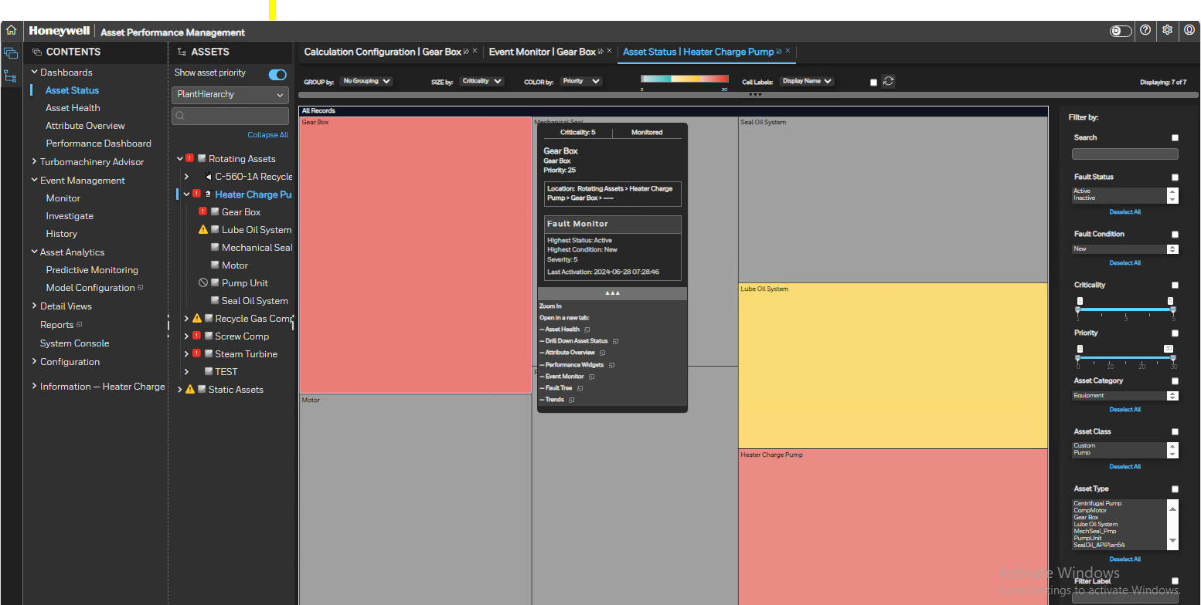
Asset Status Dashboard
Once you click on the Asset Status option on the Content tab the Asset Status dashboard gets displayed.
The Asset Status dashboard displays a treemap showing the criticality and priority values of the item currently selected on the asset tree.
The Content option selected along with the selected Asset is displayed above the dashboard.
You can change the settings of the Display by:
Group- To change the property used to group the rectangles you can display the assets based on Asset Class, Asset Category, Asset Type, Criticality, Priority, Location or No Grouping.
Size- To change the property by the size of the rectangle you can select the size based on Criticality, Priority, Max Severity, Same Size.
Color- To change the property by the color of the rectangle you can select the color based on Criticality, Priority, Max Severity, Same Size. The change in color based on the selection will be visible as shown in 4.c1
3
2
1

Slide 36
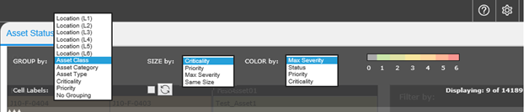
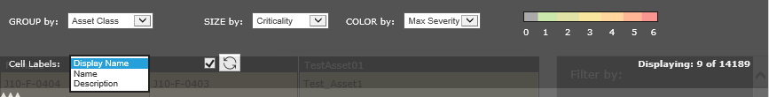
Asset Status Dashboard (Contd.)
d. Cell Labels- To change the property used to label the cells you can select by Name, Display Name or Description.
e. To reload the treemap data, click on the refresh data or select the Auto refresh check box to have the treemap data refresh on regular basis.
4.a
4.b
4.c
4.c
4.d
4.e

Slide 37
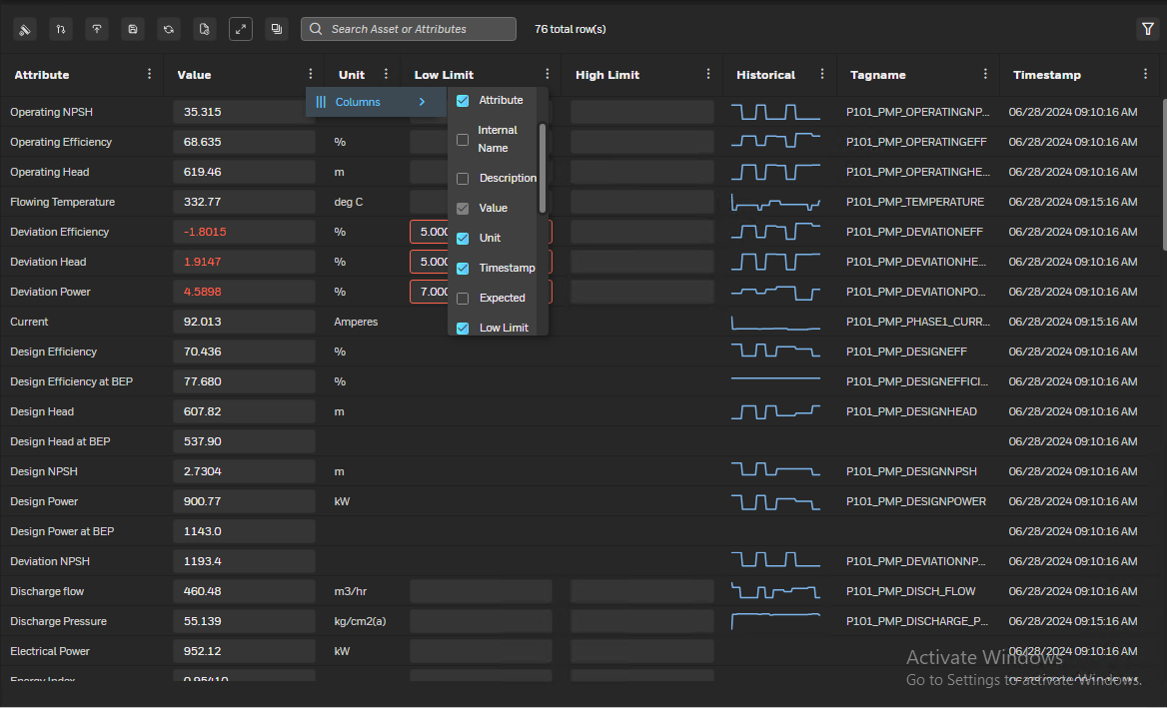
Attribute overview
The Attribute overview screen is a table containing all the attributes of the asset along with their current value.
The table can be configured to show the below fields:
Asset
Attribute Name
Attribute Description
Current Value
Unit of Measurement
Timestamp
Low Limit
High Limit
Expected Value
Deviation from expected
Historical Trend
Minimum value within last 2 hrs
Maximum value within last 2 hrs
Average value of last 2 hrs
Quality of data
Category of attribute

Slide 38
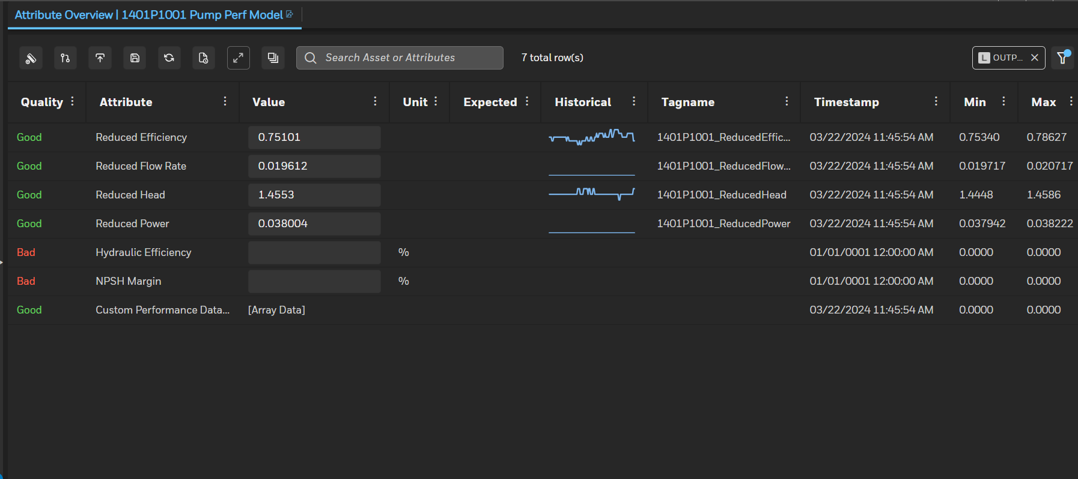
Attribute Overview
2.a
2.c
2.e
3
2.b
2.d
2.f
2.g
Attribute Overview
Attribute overview lists all the attributes applicable to selected Asset with its current value, UoM and Quick trend, Min/Max/Avg for last two hours.
Following options are available for user to
Show values in Asset Type UOM
Include child Assets attributes in current view
Export selected or all attribute data in excel
Save changes (if any value updated manually)
Refresh Attribute overview
Display the Property for selected attribute
Filters the attributes based on asset or attribute.
Clicking on historical (quick trend) opens trend in another tab with more trend options
1

Slide 39
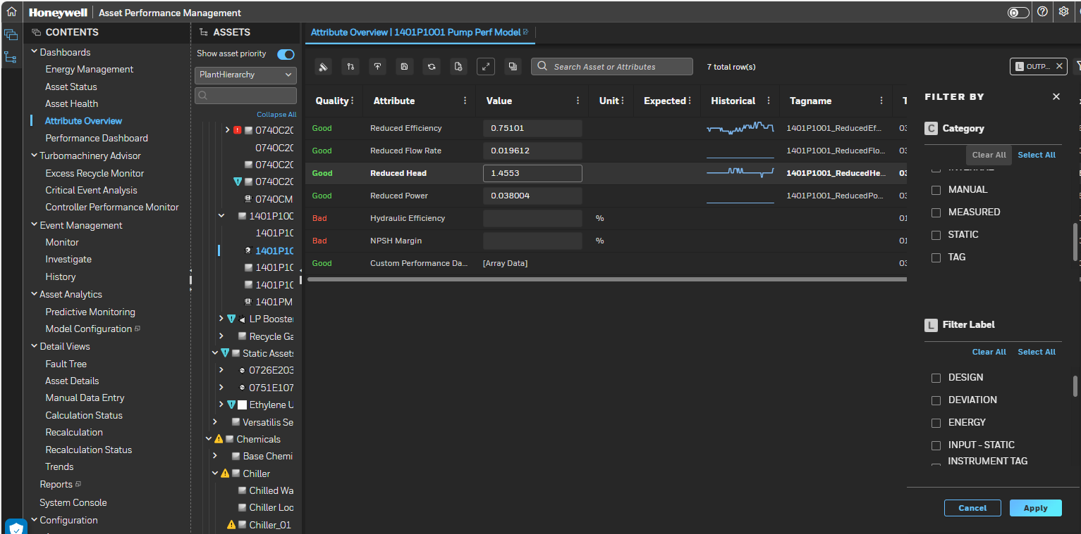
Attribute Overview-Cont
4
Attribute Overview
Additional filter criteria can be selected. Click to hide or unhide filter option
Attributes can be further filtered based on “category” or “filter labels” to load attributes having the selected filter label or category.
5

Slide 40
Event workflow

Slide 41
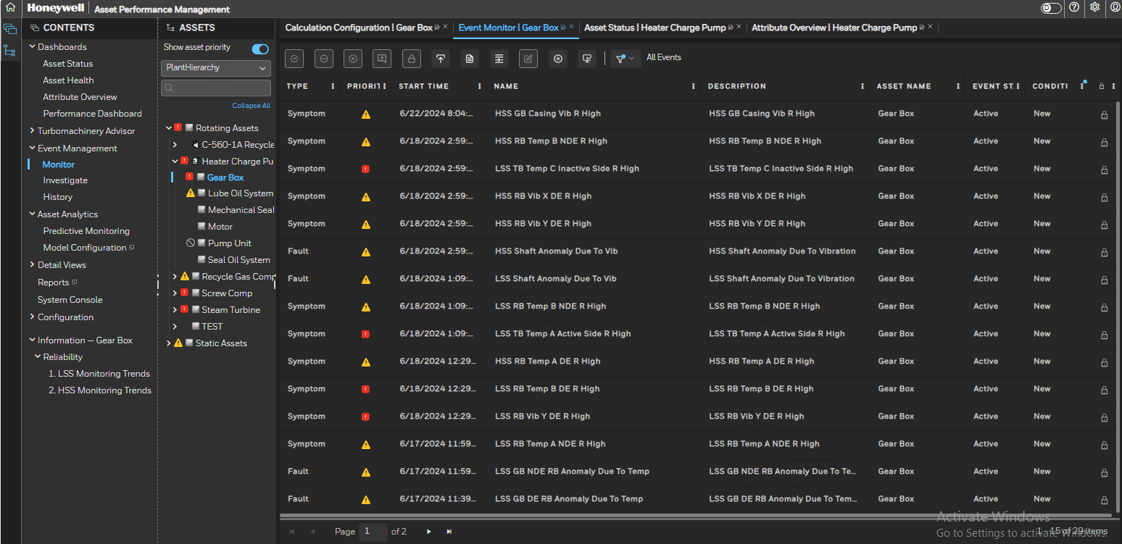
Event Management
The Event Management view consists of three sections-
Monitor
Investigate
History
2) Based on the selection the related section is displayed for the selected Asset.
1.a
1
1.b
1.c

Slide 42
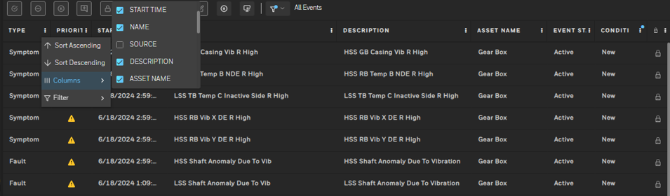
Event monitor
The Event Monitor screen is a table containing all the events (Faults/Symptoms) of the asset selected.
The table can be configured to show the below fields:
Asset Name
Event Start Time
Event Name
Event Description
Event Status (Active/Inactive)
Priority
Event End Time
Fault Severity
Locked
Asset Criticality
Asset Status
Fault Condition
Event Type (Fault/Symptom)
Event Owner
Asset Category
Asset Path

Slide 43
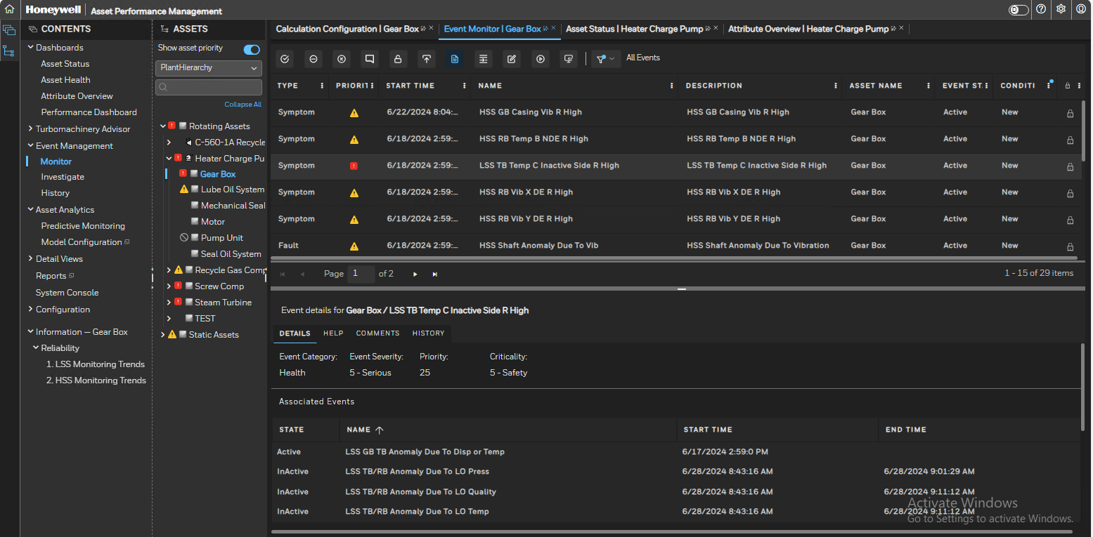
Event monitor (Contd.)
Selecting any event will provide its details in the bottom pane which includes the following:
Details on the event and associated expression
Help documents and links
Trends of the attributes at the time of the event
Comments entered by users
Past history of the selected event

Slide 44
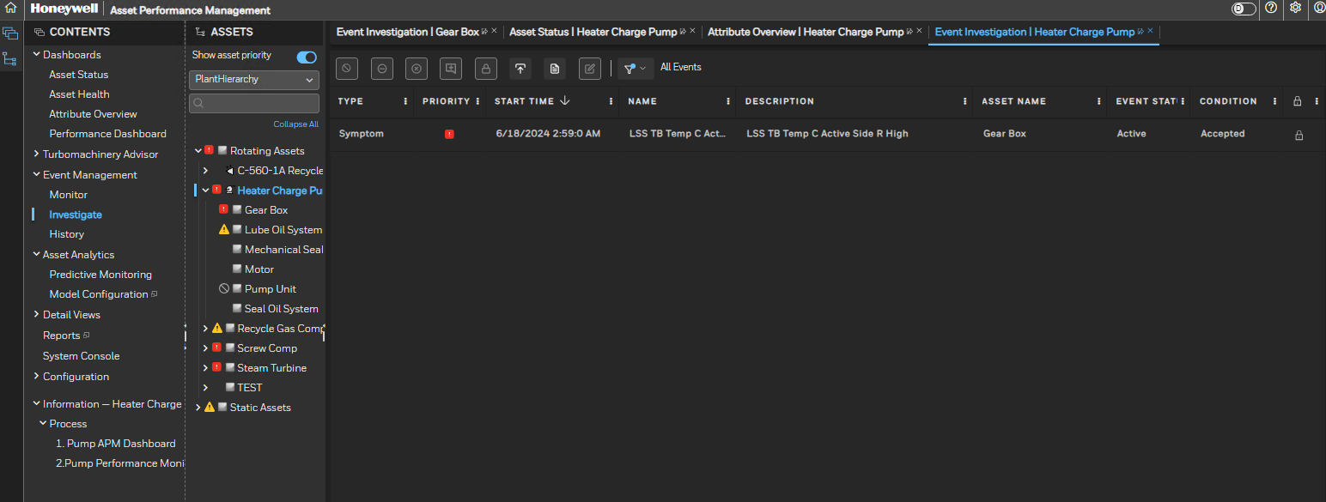
Investigate
On Accepting any Fault from the Monitor View for any Asset we can see the Accepted Fault on the Investigate View. The following details are displayed on the Investigate View-
Asset Name
Start time
Name
Description
Fault Status
Condition
Lock
Priority
Unaccept
Reject
Close
Add Comment
Lock
Show Fault Detail
Export
1

Slide 45
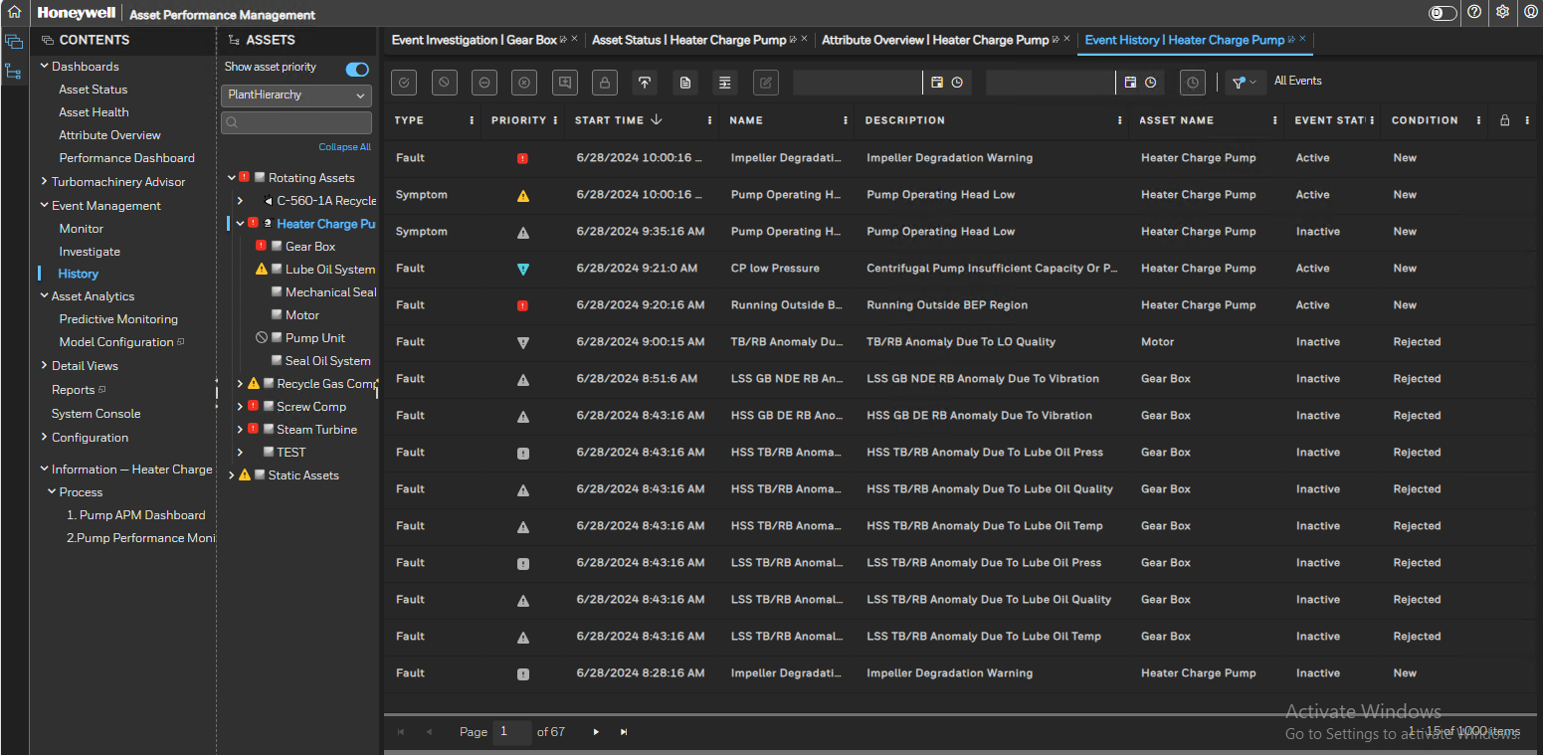
History
To check the History of events for a selected asset you can Click on History. The following details are displayed on the History View-
Asset Name
Start time
Name
Description
Fault Status
Condition
Lock
Priority
Unaccept
Reject
Close
Add Comment
Lock
Show Fault Detail
Export
Filter Items From
Filter Items To
Filter Items by Time Range
1

Slide 46
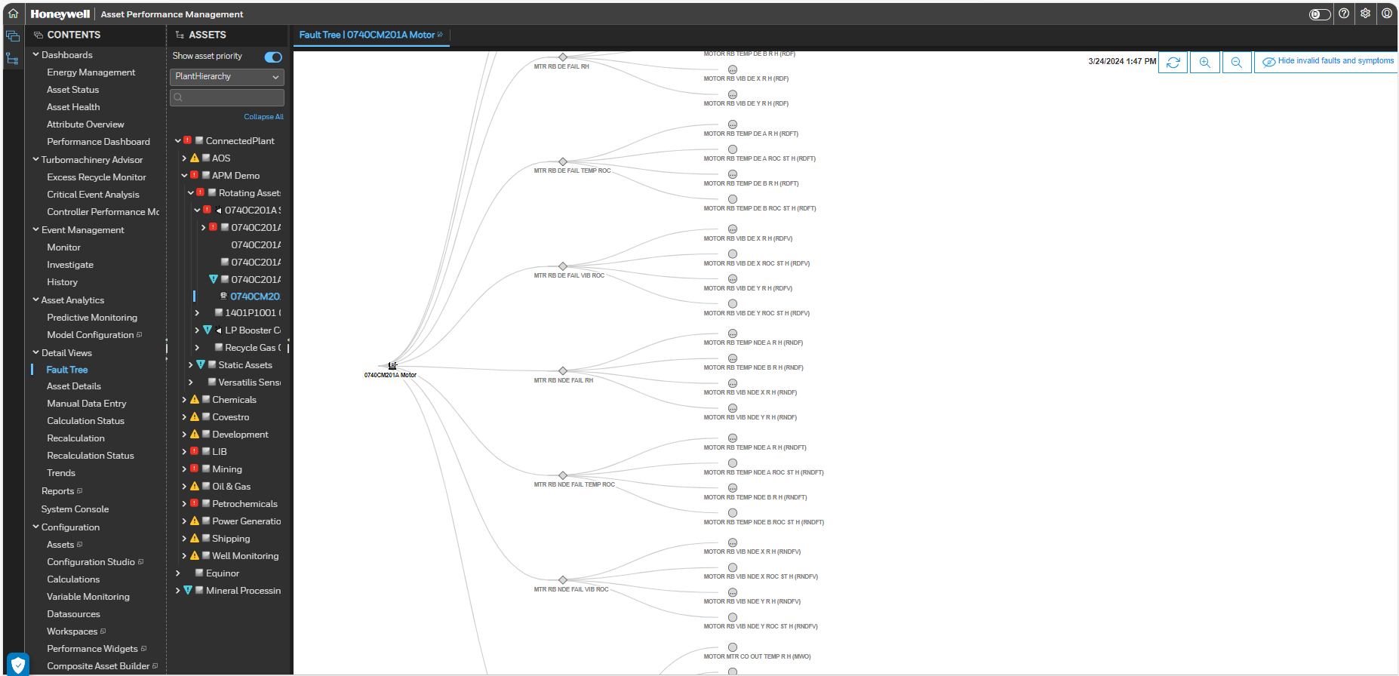
Details View
2
The Detail Views consist of seven sections-
Fault Tree
Asset Details
Manual Data Entry
Calculation Status
Recalculation
Recalculation Status
Trends
Reports
System Console
Based on the selection the related section is displayed for the selected Asset
For example, here Fault Tree is selected.
1
a
b
c
d
e
f
g
h
i

Slide 47
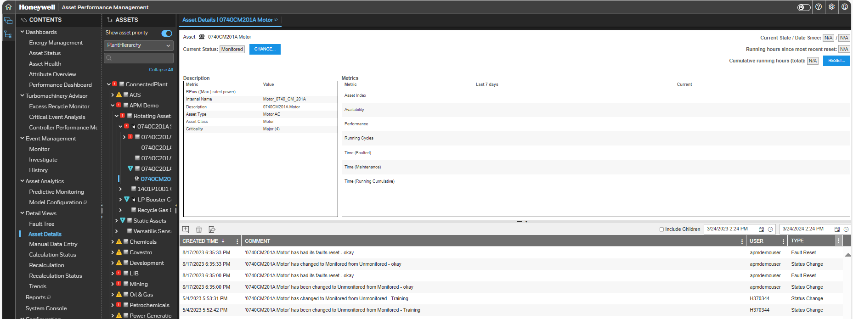
Asset Details
To check the Asset Details for a selected asset you can Click on Asset Details. The following details are displayed-
Asset
Current Status
Current State/ Date Since
Running hours since most recent reset
Cumulative running hours (total)
Description of the Asset
Changes done in the Description if any
a
c
b
f
d
e
g
1

Slide 48
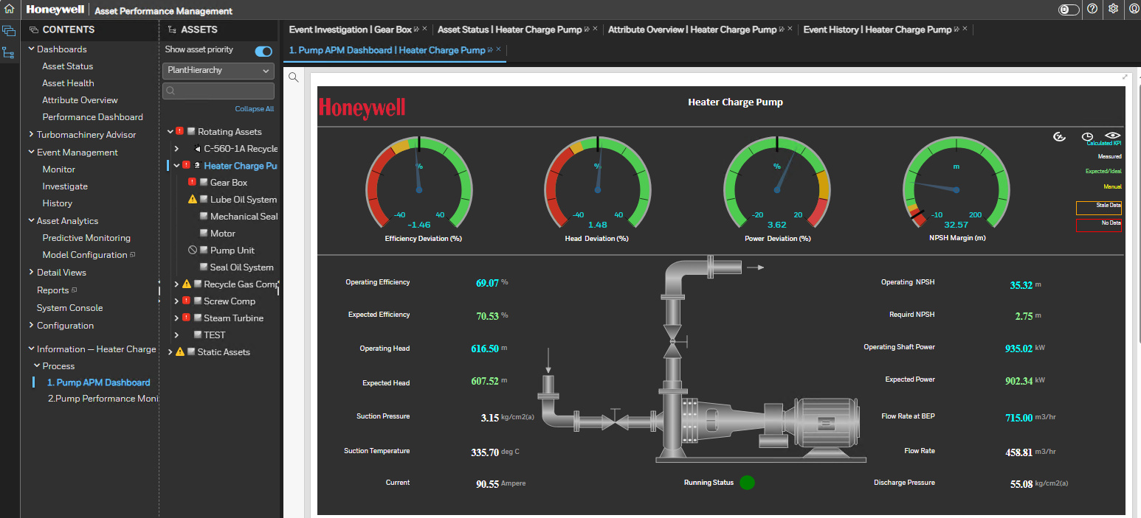
Asset GRAPHICS

Slide 49
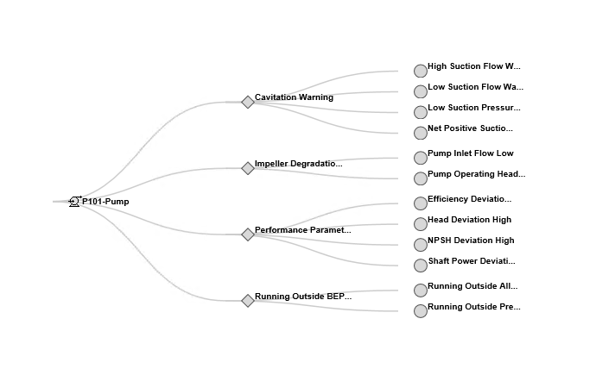
Fault tree
Fault tree is like a fish bone diagram.
It is a graphical representation in the form of tree for all the possible events (active or inactive) of one asset or of one group of assets or unit or entire site
The red color represent the active events. The grey are inactive events.
As the color is propagating in the asset hierarchy this fault tree is important to understand what is the root cause of the problems at the unit level.

Slide 50
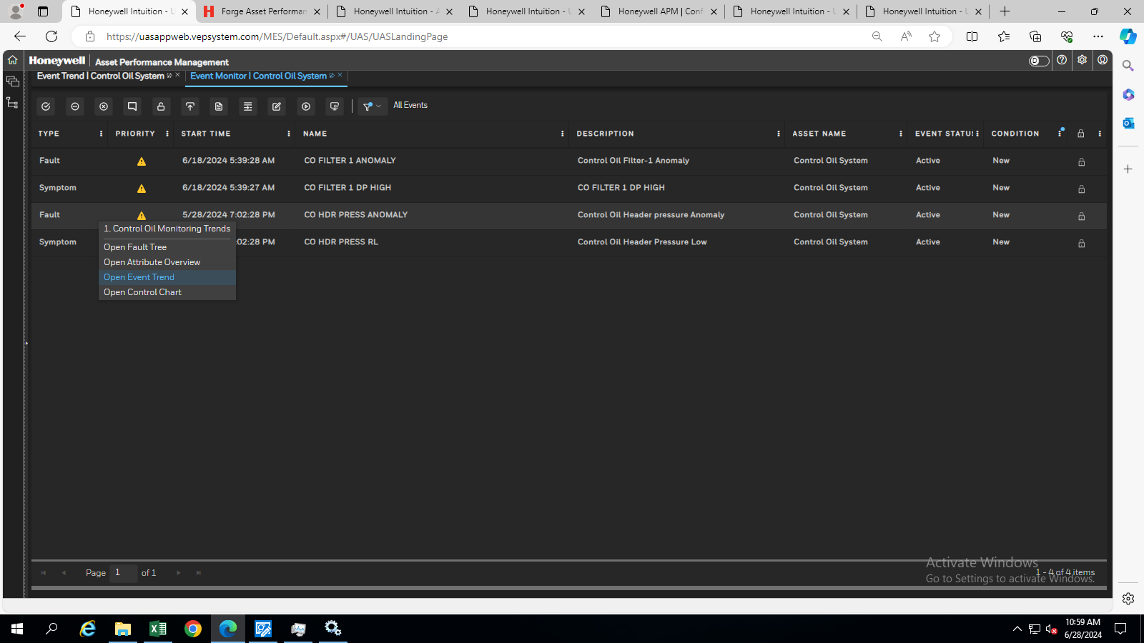
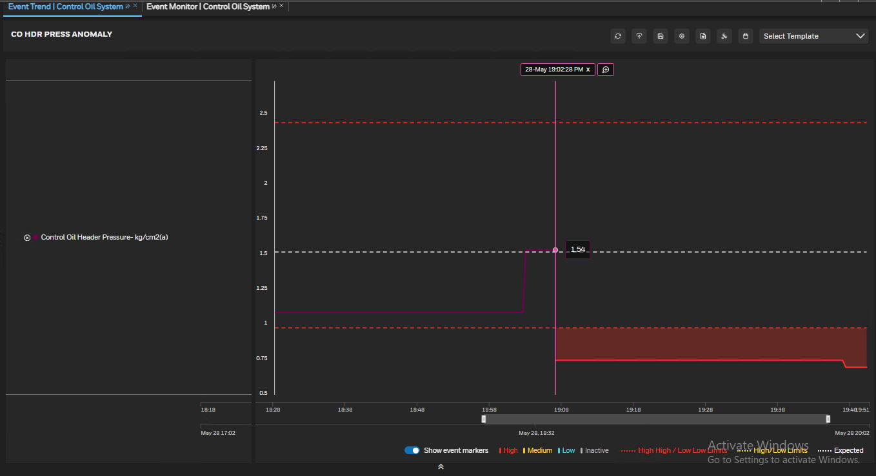
Event trends
From Event monitor right click on the fault
Select open event trends
Window is opened with high, low, expected and actual values.
By analysing the trends we come to know that why and when the fault is triggered.

Slide 51
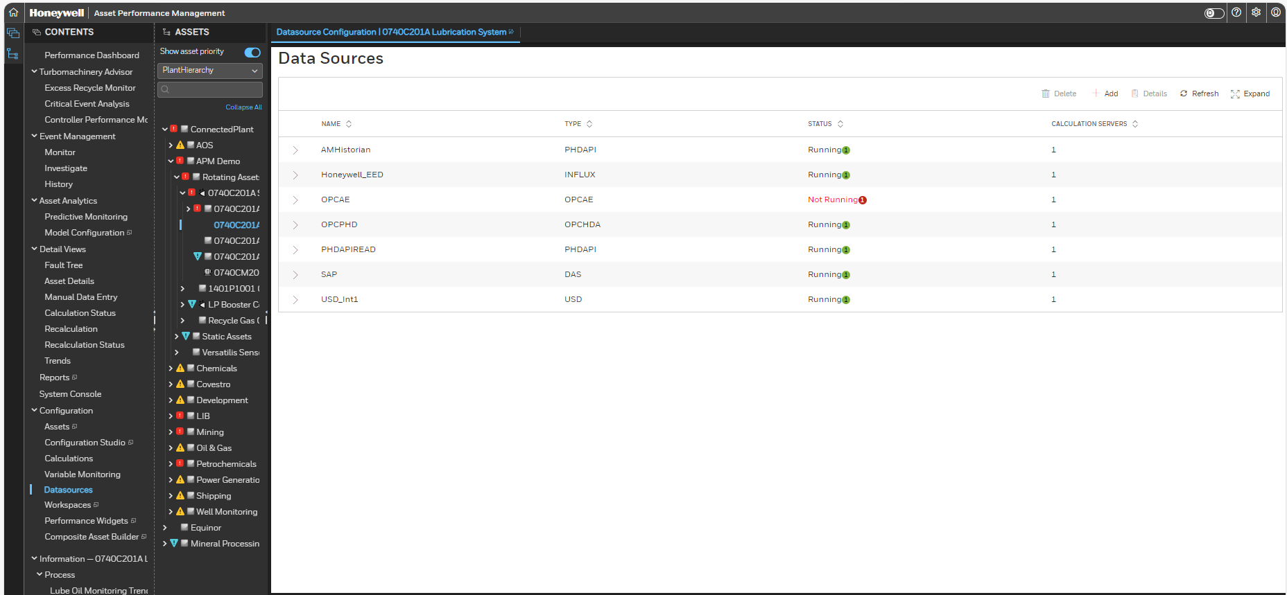
Monitor external data sources

Slide 52
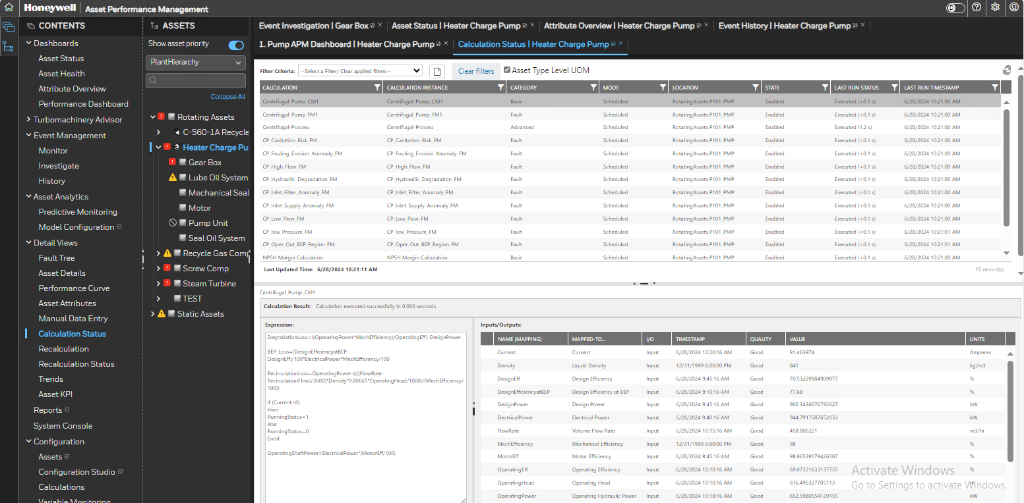
Calculation status viewer

Slide 53
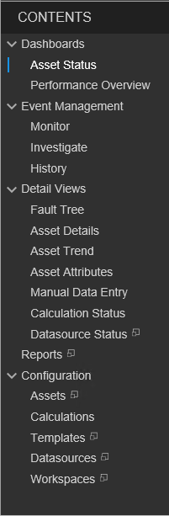
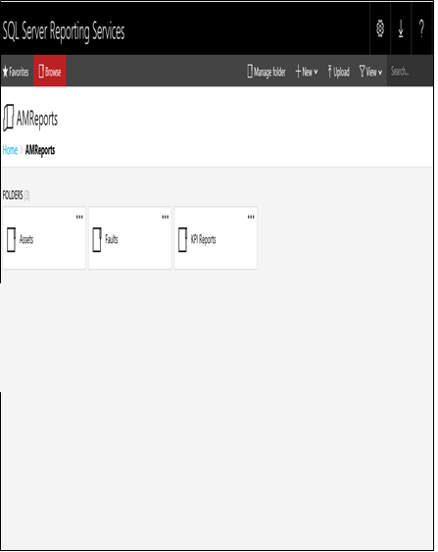
Reports
3
To check the Reports configured in Asset Sentinel you can click on Reports on the Content Tree.
You can click on the Mouse over to open the reports on a new page.
The SQL server reporting services(SSRS) reports page will get displayed.
In AMReports there are 2 Sections- Folders and Paginated Reports.
In Folders we have reports based on-
Assets
Faults
KPI Reports
2
5.b
5
5.c
5.a
1

Slide 54
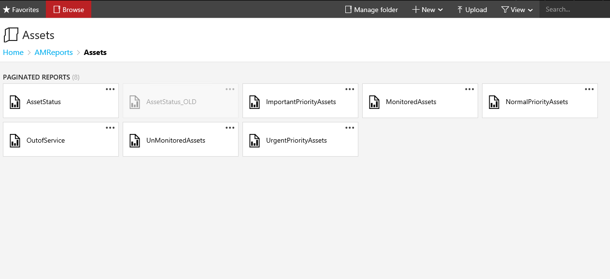
Reports (Contd.)
7
On clicking on the Asset Tab, a new page that consist of all the Asset related reports will open.
The page displays the below Reports-
AssetStatus
AssetStatus_OLD
ImportantPriorityAssets
MonitoredAssets
NormalPriorityAssets
OutofService
UnMonitoredAssets
UrgentPriorityAssets
You can click on the reports to open them.
The other options available are-
Manage Folder
New
Upload
View
Search
8.f
8.a
8.g
8.b
8.c
8.h
8.e
10.a
10.b
10.c
10.d
10.e
8.d

Slide 55
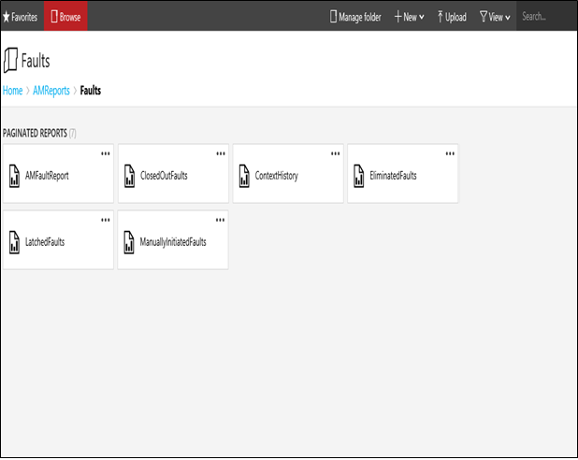
Reports (Contd.)
On clicking on the Fault Tab, a new page that consist of all the Fault related reports will open.
The page displays the below Reports-
AMFaultReport
ClosedOutFaults
ContextHistory
EstimatedFaults
LatchedFaults
ManuallyInitiatedFaults
You can click on the reports to open them.(Refer slide Faults Reports and Metrics)
The other options available are-
Manage Folder
New
Upload
View
Search
12.e
12.b
12.f
11
12.a
14.a
14.b
14.c
14.d
14.e
12.c
12.d

Slide 56
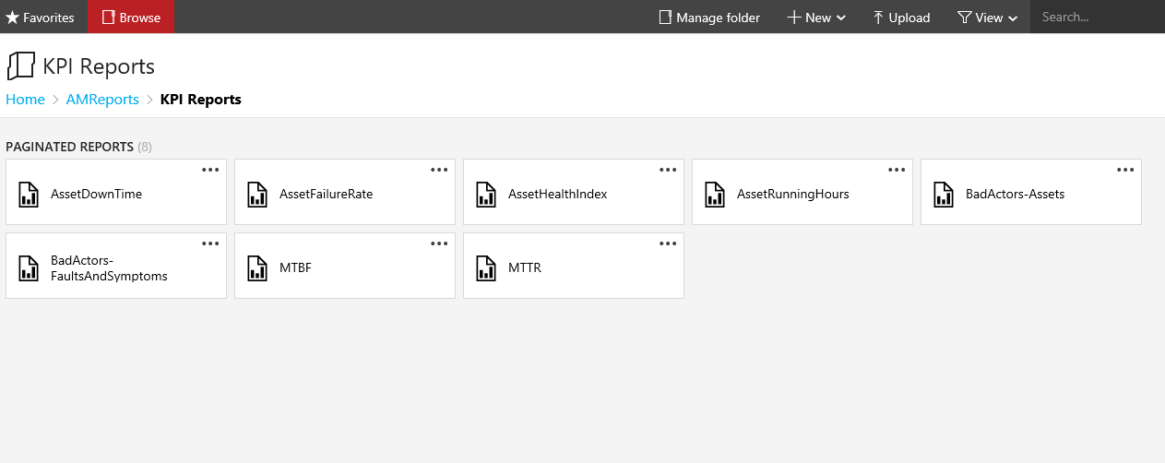
Reports (Contd.)
On clicking on the Fault Tab, a new page that consist of all the Fault related reports will open.
The page displays the below Reports-
AssetDownTime
AssetFailureRate
AssetHealthIndex
AssetRunningHours
BadActors-Asset
BadActors-FaultAndSymptoms
MTBF
MTTR
You can click on the reports to open them
The other options available are-
Manage Folder
New
Upload
View
Search
16.f
15
16.h
16.g
16.a
16.b
16.c
18.a
18.b
18.c
18.d
18.e
16.d
16.e

Slide 57
MODULE 2
APM DCT

Slide 58
APM dct
The Data Collection Template (DCT) is the pre-requisite for doing the Asset Sentinel Configurations/data loading.

Slide 59
THANK YOU

